Slide 1
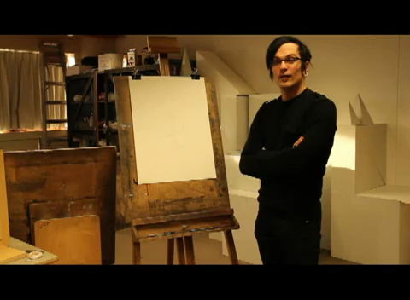
[ Painting using Perspective Machine ]
https://www.youtube.com/watch?v=8s1LzIrWbE8

